Slide 1
Secure Data Hiding in Image Using Steganography
CAPSTONE PROJECT
Presented By: Riya Patil
Student Name : Patil Riya Shivaji
College Name & Department : Bharti Vidyapeeth’s College Of Engineering For Women [ Information Technology ]

Slide 2
OUTLINE
Problem Statement
Technology used
Wow factor
End users
Result
Conclusion
Git-hub Link
Future scope

Slide 3
Problem Statement
Develop a secure image steganography tool.
Implement encryption and decryption of hidden messages within image files.
Ensure secure communication by requiring a passkey for both encryption and decryption.
Implement a retry mechanism with a lockout after multiple failed decryption attempts.

Slide 4
Technology used
OpenCV (cv2) for image processing
NumPy for numerical operations
Time module for handling time-related tasks
OS module for interacting with the operating system

Slide 5
Wow factors
Dual-layer security: XOR encryption combined with LSB steganography.
Retry mechanism with lockout for enhanced security.
User-friendly interface with clear prompts and feedback.
Robust error handling for various scenarios.

Slide 6
End users
Individuals seeking secure communication channels.
Professionals in cybersecurity and data privacy.
Hobbyists interested in steganography and image processing.

Slide 7
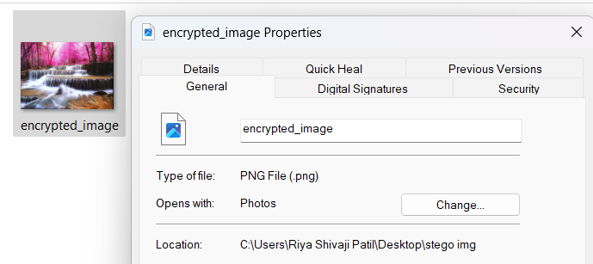

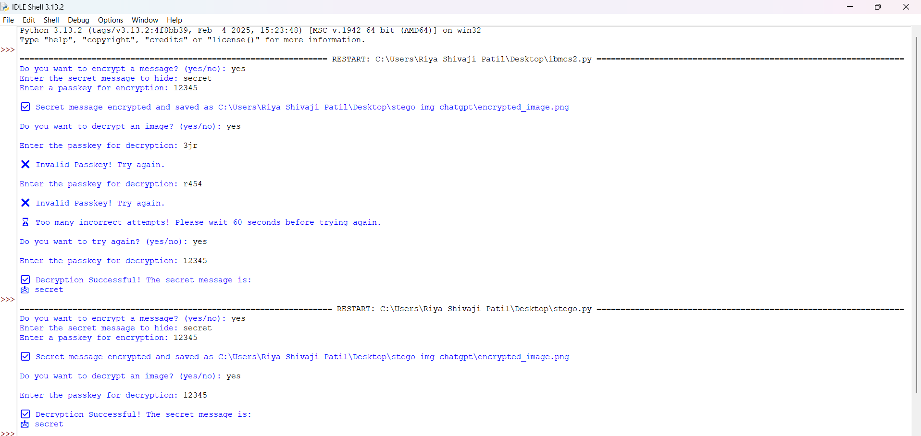
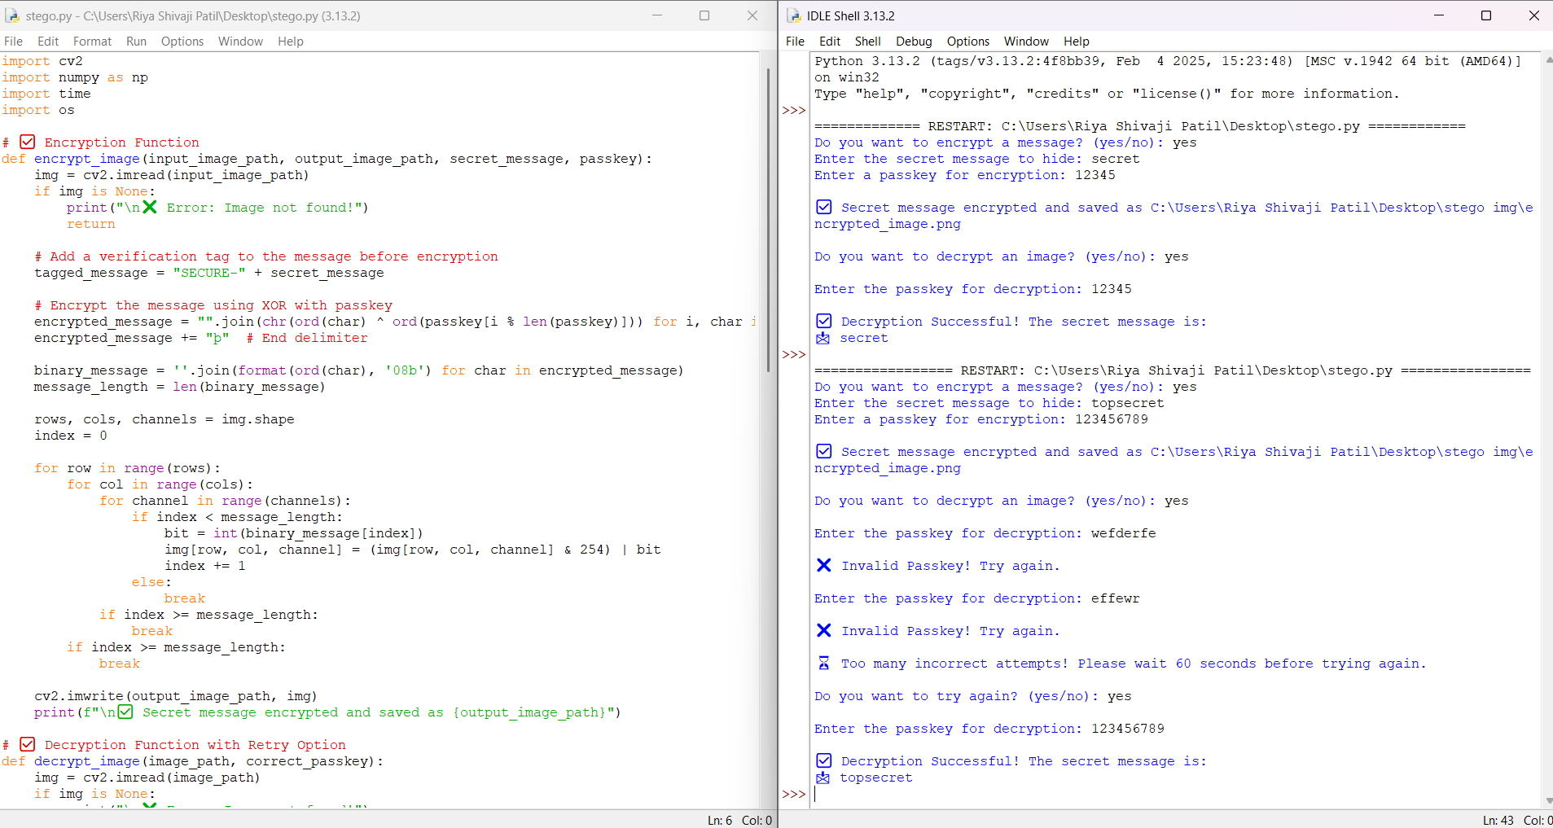

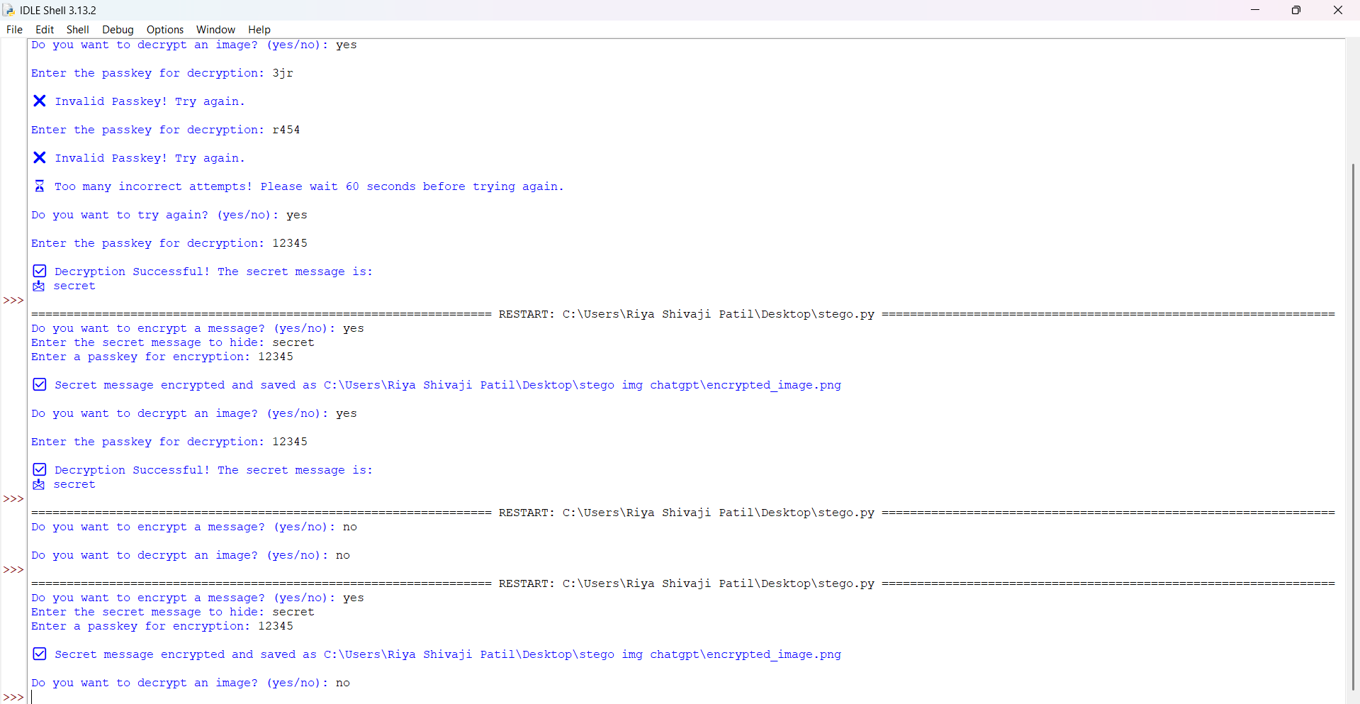
Results
Proof of encrypted image image
Sample image
Output image 1
Program along with Output image
Encrypted image
Output image 2

Slide 8
Conclusion
Developed a secure image steganography tool with encryption and decryption capabilities.
Implemented a retry mechanism with a lockout for enhanced security.
Demonstrated the feasibility of secure communication using image steganography.
Tool provides a user-friendly interface for encrypting and decrypting messages.

Slide 9
GitHub Link
GitHub Repository Link : https://github.com/riyashivajipatil/AICTECyberSecurity.git

Slide 10
Future scope(optional)
Implement more advanced encryption algorithms.
Add support for different image formats.
Develop a graphical user interface (GUI) for the tool.
Explore the possibility of hiding different file types within images.

Slide 11
THANK YOU

